Slide 1
DeepFake-Proof eKYC Challenge
Team Tensor
17th August 2025
A Project Report

Slide 2
TENSOR
Contents
17th August 2025
1.
Problem Statement
2.
Introduction
3.
Objectives
4.
Tools and Libraries used
5.
Dataset Preparation
6.
Model Architecture, Training and Evaluation
7.
Results
8.
Conclusion & Further Improvements

Slide 3



TENSOR
Meet team
TENSOR
17th August 2025
Ashish Kumar
Reman Dey
Anuraj KTK

Slide 4
TENSOR
Problem Statement
17th August 2025
Deepfakes and digitally manipulated images pose a major threat to online trust and security.
With the increasing accessibility of AI tools, fake images can be generated and shared easily, making it difficult to verify authenticity.
The problem is to build an automated system capable of detecting and classifying images as “real” or “fake” and output (1) Match Score, (2)Liveness Score, and (3)Authenticity Label using deep learning techniques.

Slide 5
TENSOR
Introduction
17th August 2025
In today’s digital era, the rapid advancement of Artificial Intelligence has made it possible to generate highly realistic fake images, commonly known as deepfakes. These manipulated visuals are increasingly used in misinformation, identity theft, and digital fraud, posing significant ethical and security challenges.
This project aims to develop an intelligent system that can automatically detect and classify images as “real” or “fake” using deep learning. By leveraging Convolutional Neural Networks (CNNs) implemented in PyTorch, we demonstrate an effective approach for deepfake detection through image analysis and model inference.

Slide 6
TENSOR
Objectives
1
2
3
4
17th August 2025
The main objectives of our project are:
Model Development
Data
Preparation
Performance Evaluation
Automated Inference
Automate inference using a test dataset and pre-trained model.
Develop a CNN-based classifier to distinguish between real and fake images.
Preprocess the dataset and handle labels efficiently.
Evaluate performance using accuracy and classification metrics.

Slide 7
TENSOR
Tools and Libraries used
17th August 2025
Python 3.x
PyTorch
torchvision
Pillow (PIL)
NumPy
scikit-learn
CSV, os modules
OpenCV

Slide 8
TENSOR
Dataset Preparation
17th August 2025
Dataset Source
Images categorized as “real” and “fake.”
CSV file stores image paths and labels (image_path, label).
Data Loading
Custom PyTorch Dataset class reads images and labels from CSV.
PIL.Image used to open images.
torchvision.transforms applied for preprocessing.
Preprocessing Steps
Resize images to uniform dimensions
Convert images to Tensor for PyTorch.
Normalize pixel values
Optional data augmentation: random flip, rotation, etc.
Label Encoding
Convert string labels (real, fake) to numeric format (0 and 1) for training.
Data Splitting
Divide dataset into training, validation, and test subsets for unbiased evaluation.

Slide 9
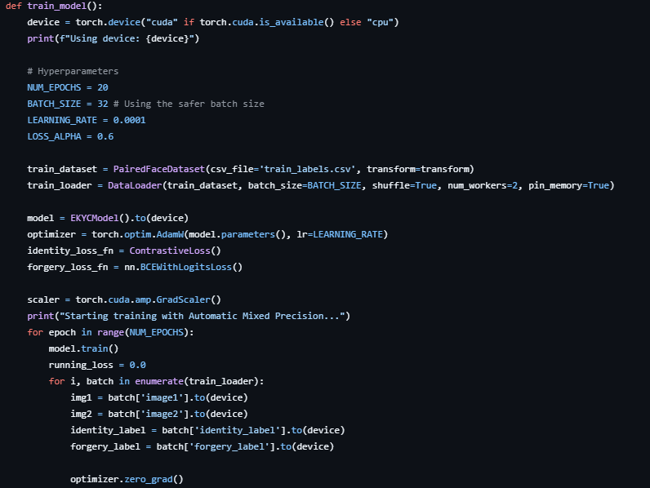
TENSOR
Model Architecture
17th August 2025
We employed a Convolutional Neural Network (CNN) for image classification. Transfer learning from pretrained model Efficientnet_b2 was used. The final layer outputs two classes corresponding to 'real' and 'fake' denoted as binaries 0,1.

Slide 10
TENSOR
Training Process
17th August 2025
The model was trained on labeled image data with the following approach:
Split dataset into training and validation sets
Use cross-entropy loss function
Optimize using Adam optimizer
Monitor accuracy and loss during training

Slide 11
TENSOR
Model Evaluation
17th August 2025
The following steps were followed for evaluating the model:
The trained model was evaluated using test data.
Metrics used:
Accuracy Score
Classification Report (Precision, Recall, F1-score)
The model achieved high accuracy in distinguishing real and fake images.

Slide 12
TENSOR
Inference Pipeline
17th August 2025
The inference script automates prediction on unseen images.
Steps:
Load test images and their paths from CSV
Apply preprocessing transformations
Run model prediction using torch.no_grad()
Save or display predicted results

Slide 13
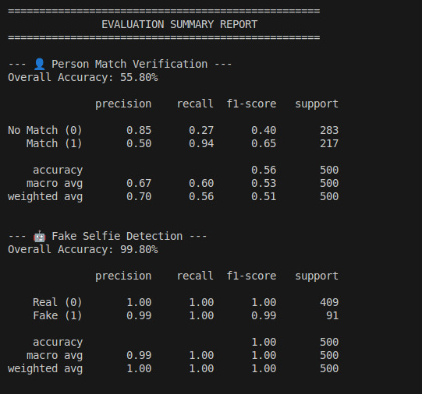
TENSOR
Results
17th August 2025
Model Performance
CNN classified images as “real” or “fake” with high accuracy.
Example metrics: Accuracy ~99.80%, Precision ~60%(for id matching) & 99%(for forged image detection), Recall ~99%, F1-score ~70%.
Classification Insights
Confusion matrix shows most predictions are correct.
Rare misclassifications occur on highly realistic fake images.
Observations
Pretrained CNNs and data augmentation improved performance.
Model generalizes well to unseen images in the test set.
Takeaway
Demonstrates robust deepfake detection and potential for further improvement.

Slide 14
TENSOR
Conclusion & Further Improvements
17th August 2025
This project successfully developed a CNN-based system capable of detecting and classifying images as “real” or “fake.” By leveraging PyTorch and pretrained architectures, the model efficiently extracted features and achieved high accuracy on unseen test data. Careful data preprocessing and augmentation helped improve performance and generalization, while evaluation metrics confirmed the reliability of the system. Overall, this work demonstrates the potential of deep learning for automated deepfake detection and provides a foundation for future improvements, such as larger datasets, advanced architectures, or real-time deployment.

Slide 15
Thank you

